Slide 1
TRUENAT MTB Plus/ Rif EQA PORTAL
External Quality Assurance for testing Truenat MTB
Log on to : www.nirtnaateqa.com

Slide 2
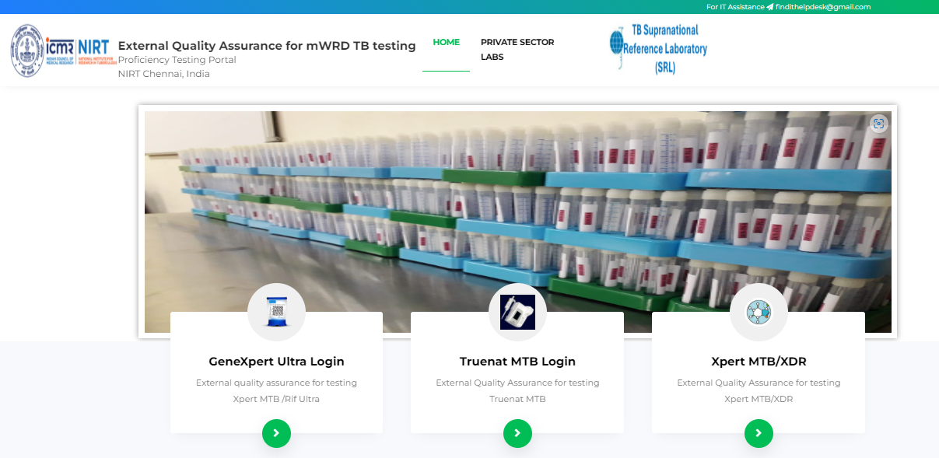
Log on to : www.nirtnaateqa.com

Slide 3
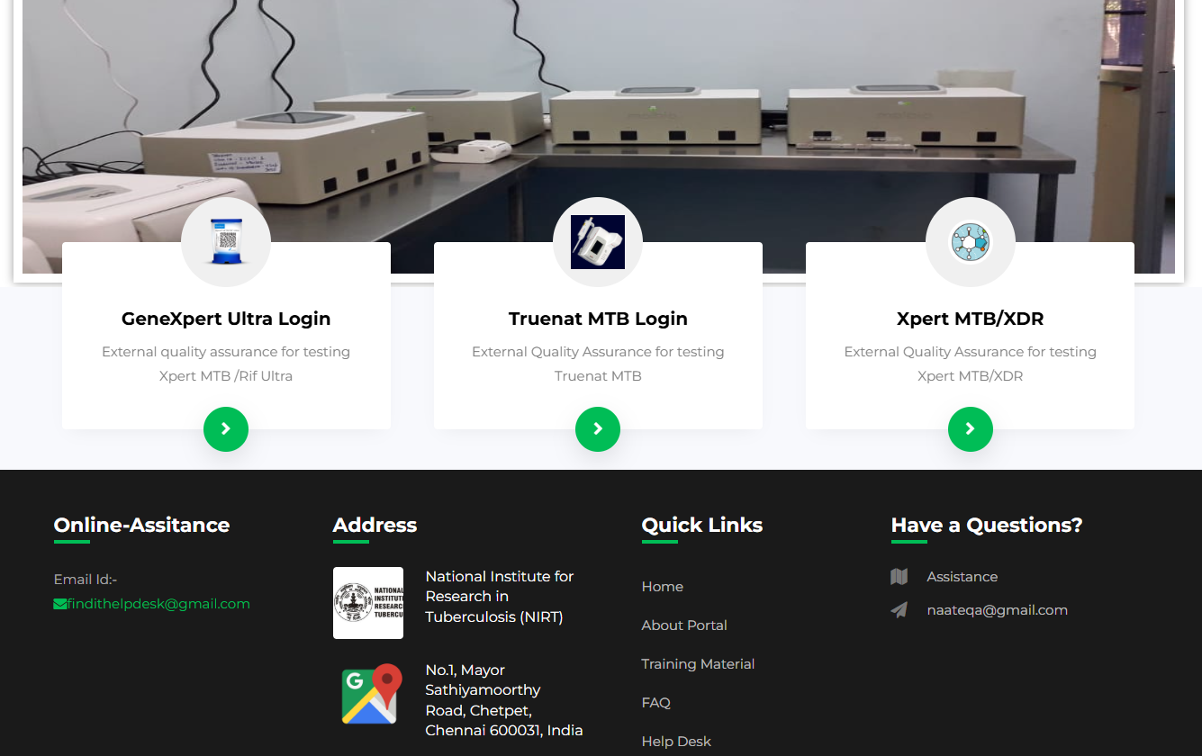
mWRD EQA Portal
Select
Truenat MTB Login for entry

Slide 4
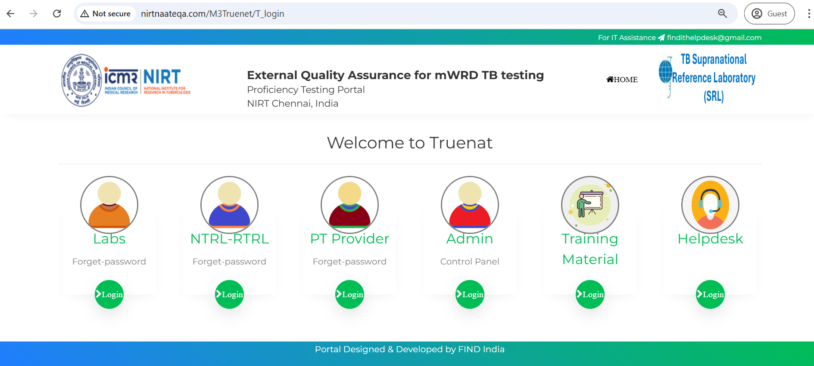
Truenat - Login page

Slide 5
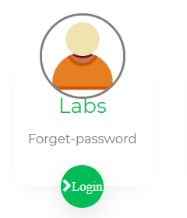
Truenat - Lab login

Slide 6
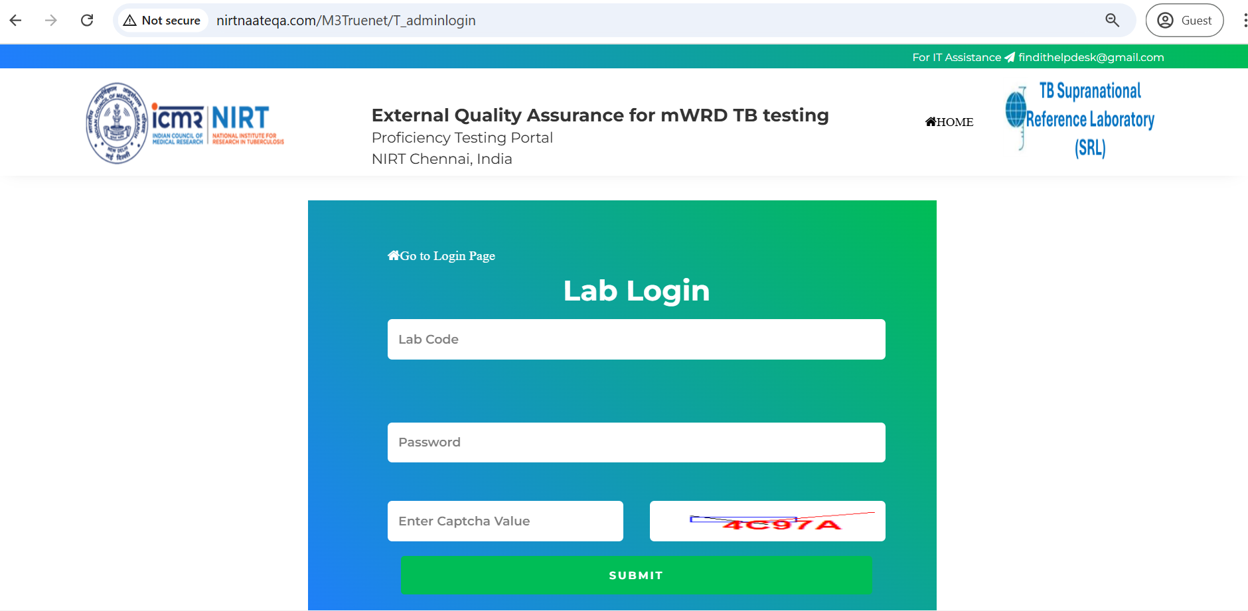
Truenat - Lab login
Enter Your
Lab Code
&
Password which You got on your registered Email-ID

Slide 7
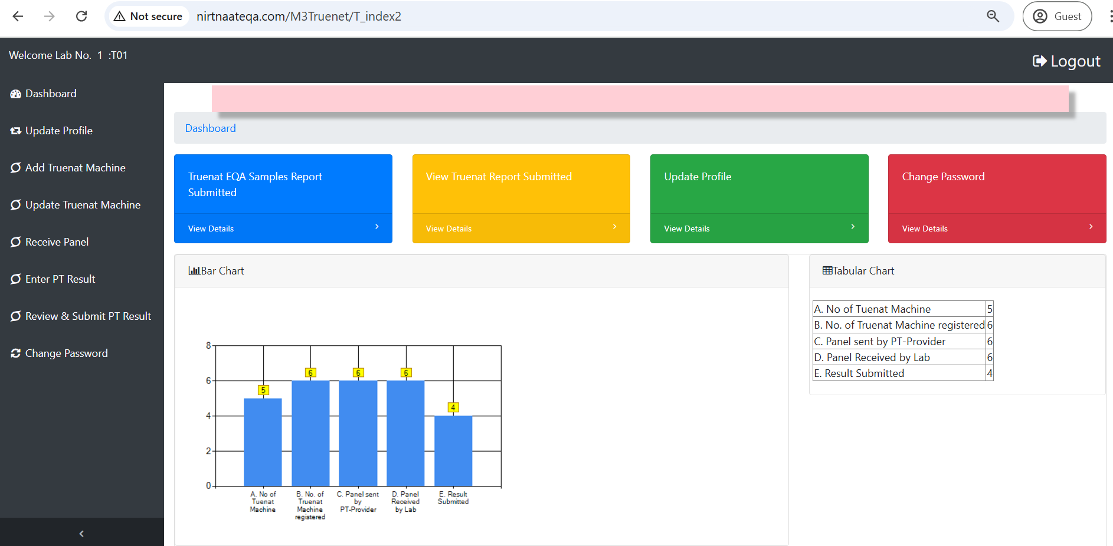
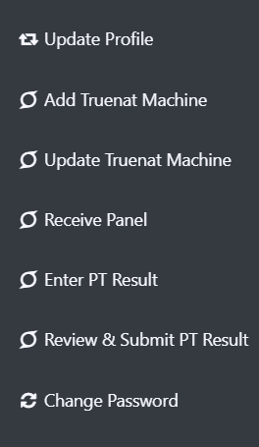
Truenat - Lab Dashboard

Slide 8
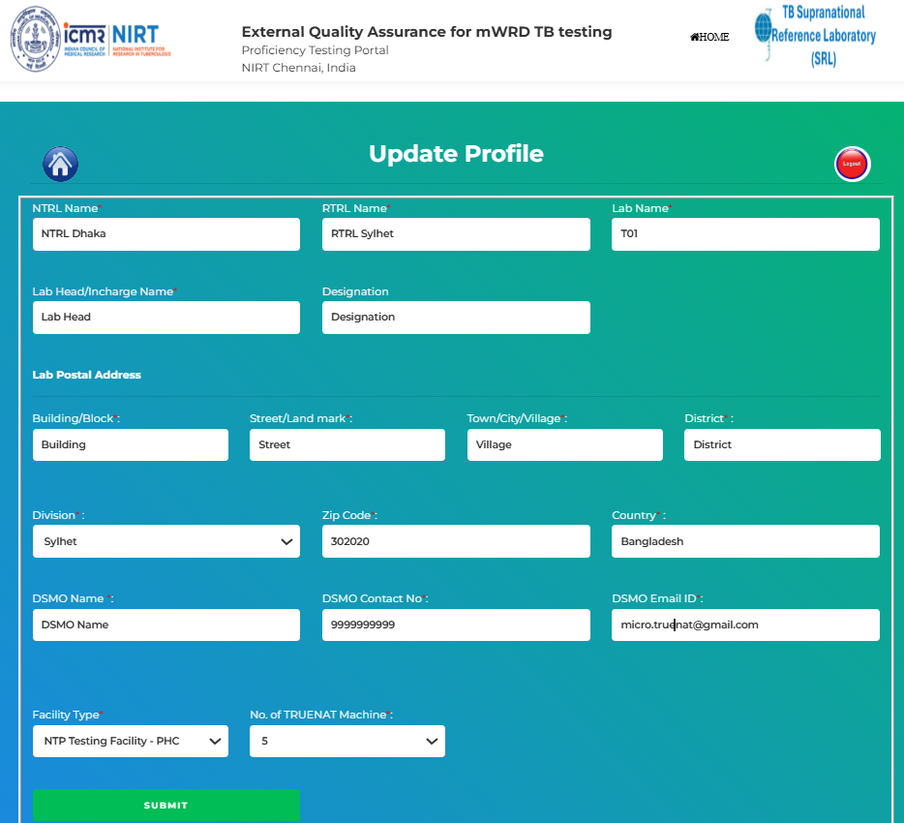
Truenat - Lab profile updation

Slide 9
Truenat - Lab Dashboard
Dashboard Left Menu
Enter the details of Truenat machine / Add Truenat Machine
Note
If a lab have multiple TRUENAT machine so need to fill ‘Add TRUENAAT Machine’ form for all the machines.

Slide 10
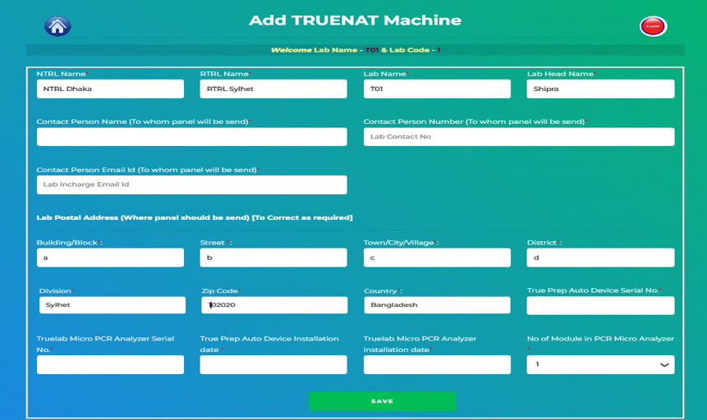
Truenat - Add Truenat Machine

Slide 11
Truenat - Update Machine
Dashboard Left Menu
Update the details of registered machine
Note
After saving the machine details you can ‘Logout’ and wait till panel receive the in the lab physically, sent by PT provider

Slide 12
Truenat - Panel Receive
Dashboard Left Menu
Go to this tab for receive the panel when you will get physically received
Note
Automatic email will generate & sent to lab through portal when PT Provider send panels to lab through portal, but you need to wait till physically panel receive in the lab.

Slide 13
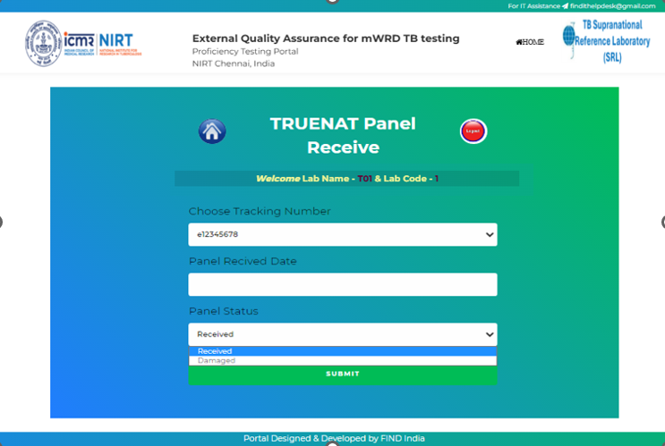
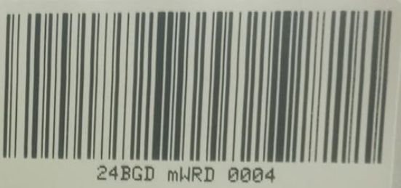
Truenat - Panel Receive
Note
Select Tracking No.
Then add panel received date
Then add panel status -
‘Received’ or Damaged
Submit the details

Slide 14
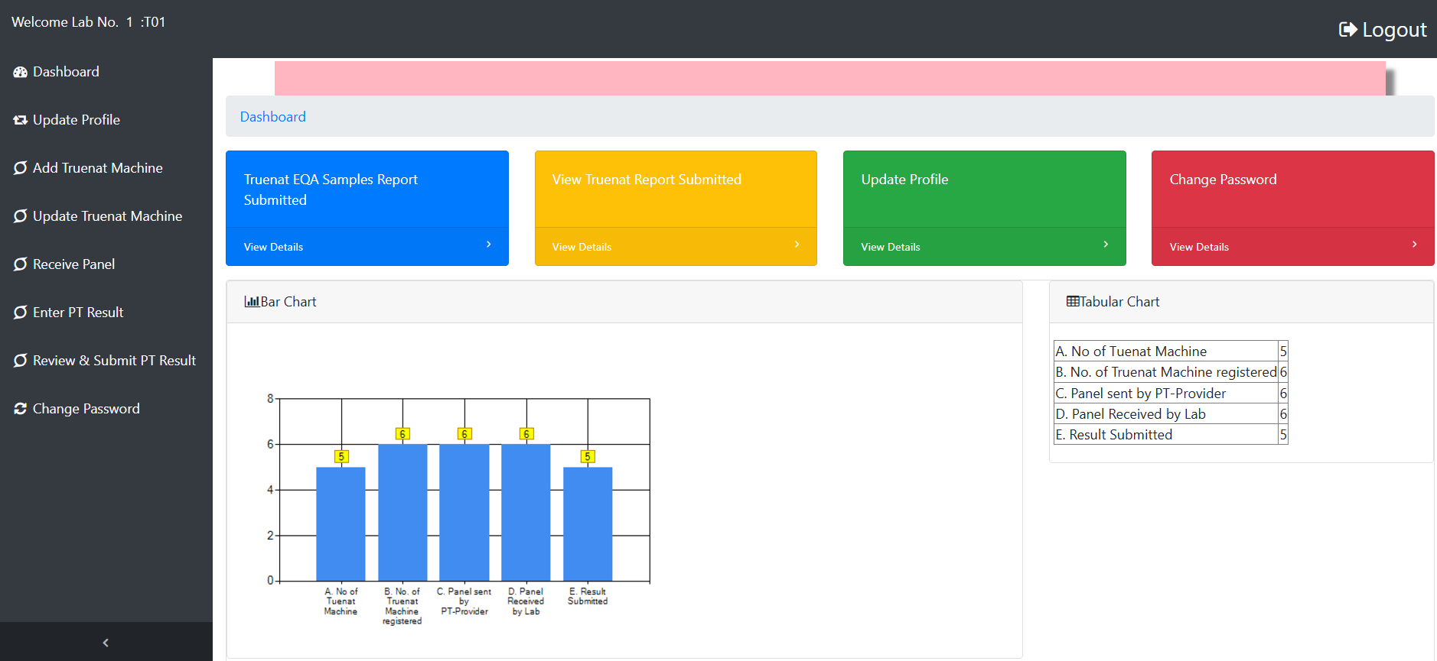
Truenat - Enter PT Result

Slide 15
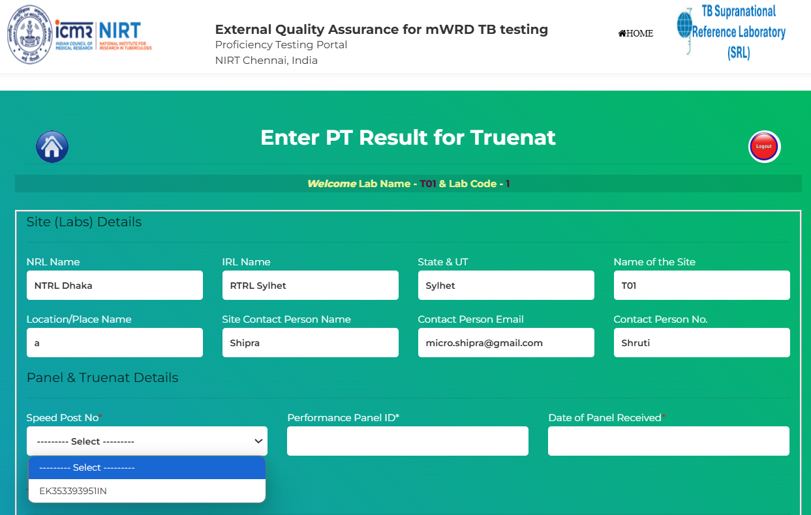
Truenat - Enter PT Result
PT Result Page fill Lab details (auto fill) but have to select Speed Post No. for other field that will auto populated

Slide 16
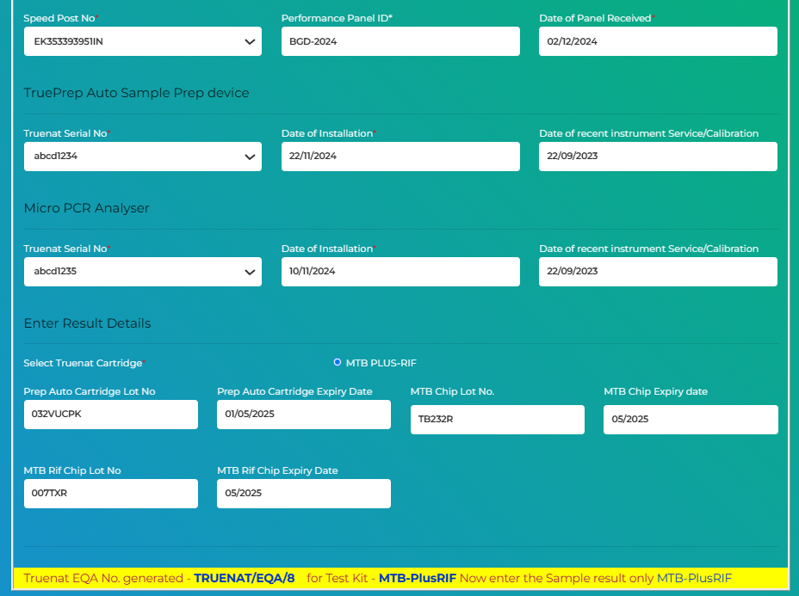
Truenat - Enter PT Result
After
Speed Post No. selection, some fields will be auto populated
& remaining details need to be added by Lab user

Slide 17
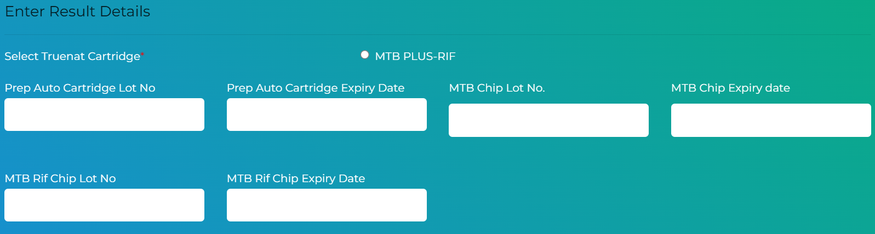
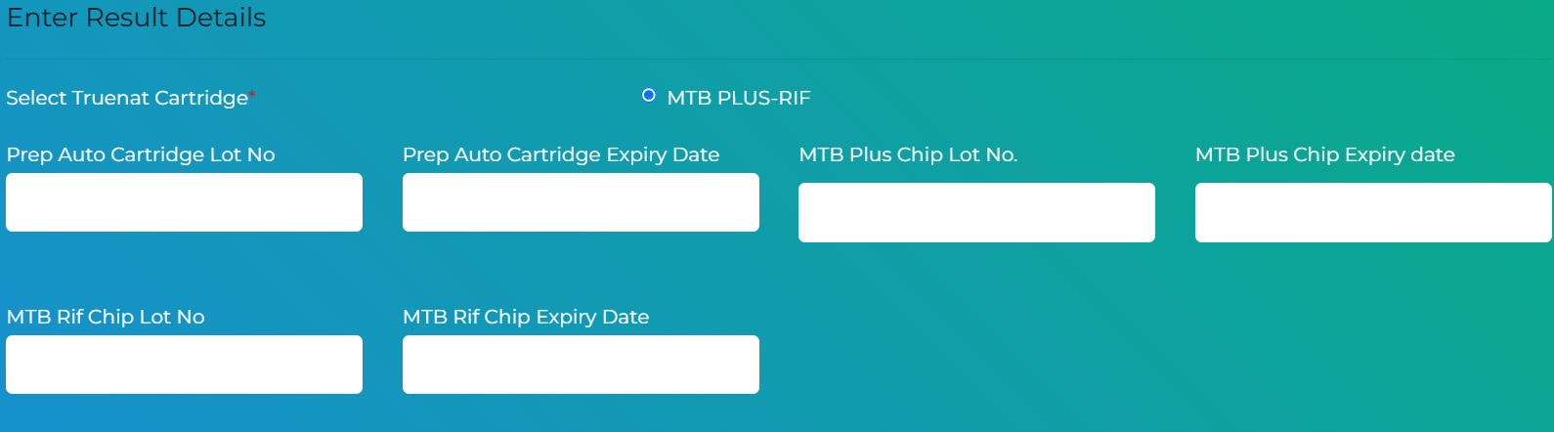
Truenat - Enter PT Result
Note : You have to select Cartridge “MTB-Rif” / “MTB Plus-Rif” before entering the data (based on which MTB assay you are using in lab “MTB” or “MTB Plus”

Slide 18
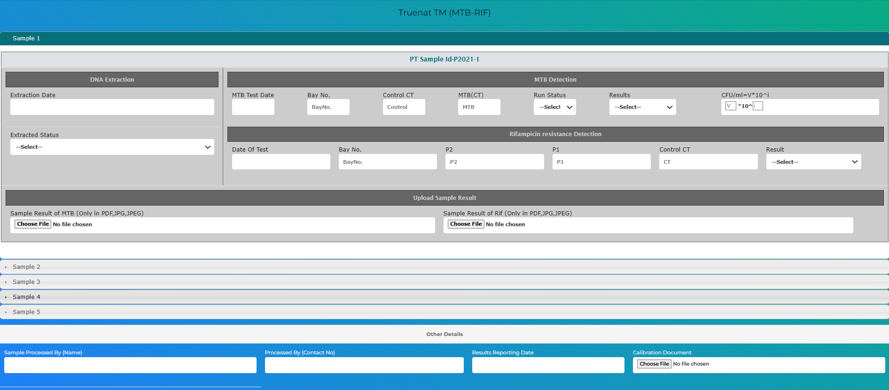
Truenat - Enter PT Result
After saving the details, you will see this form
(if you select MTB-Rif )
with documents upload for MTB & Rif Result for All 5 sample

Slide 19
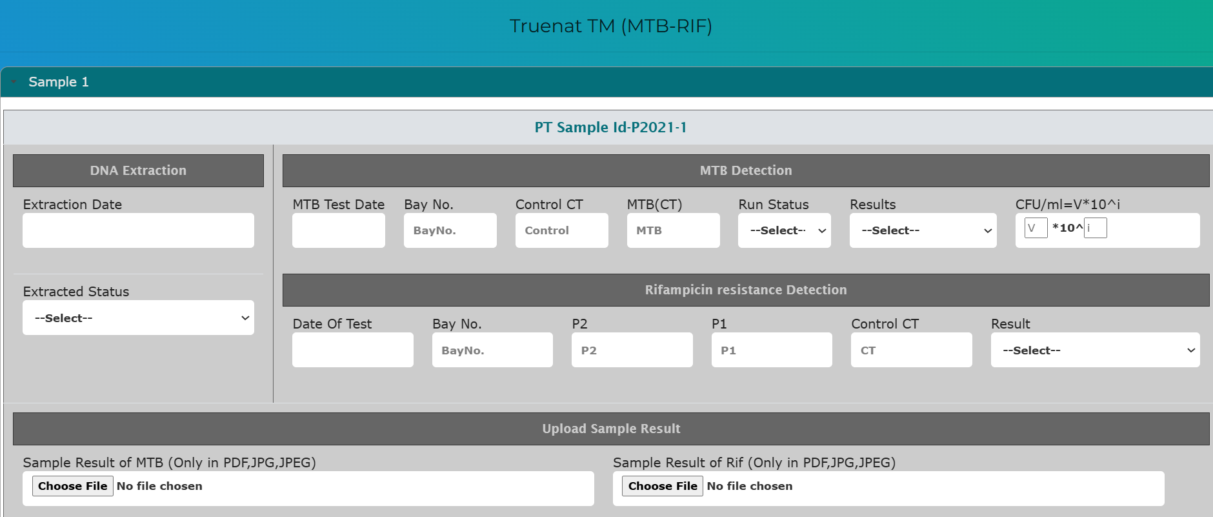
Truenat - Enter PT Result
After saving the details, you will see this form
with documents upload for MTB & Rif Result for All 5 sample

Slide 20
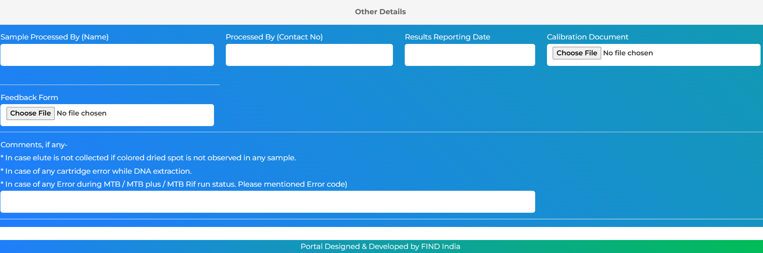
Truenat - Enter PT Result
After saving all 5 sample results, add other details and upload calibration document
And add comments (if any) and then “submit”

Slide 21
Truenat - Enter PT Result
Important Note
All details will fill one by one respectively in PT Result form.
Submit / Save button will visible one by one if before details will save successfully the next will visible.
Process for filling the PT Result form.
Save above details (with cartridge) → Enter Sample 1 to 5 (one by one) → Add other details with
calibration document & Comments→ Submit
When click on Save button you have to wait till popup message shown :-
‘File has been submitted successfully’

Slide 22
Hierarchy of Fill the PT Result
Initial Details
Sample 1
Sample 2
Sample 3
Sample 4
Sample 5
Sample Processed by Person Details
Calibration Doc
(Other Details )
Submit

Slide 23
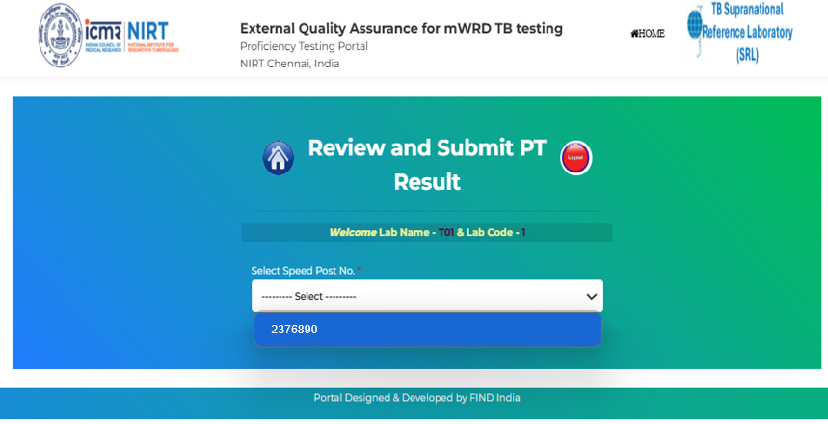
Review and Submit PT Result

Slide 24
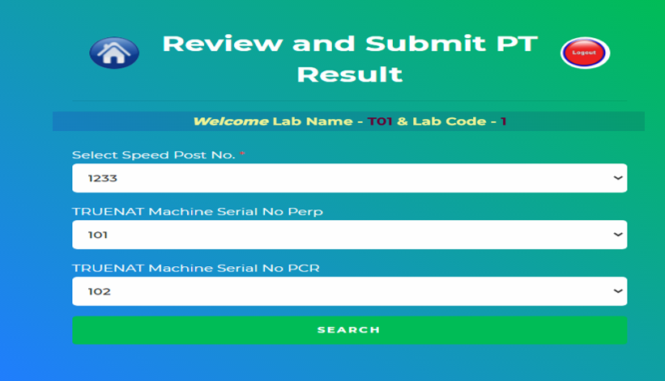
Review and Submit PT Result
Select the speed post no.
Select the Machine no for
Prep
PCR

Slide 25
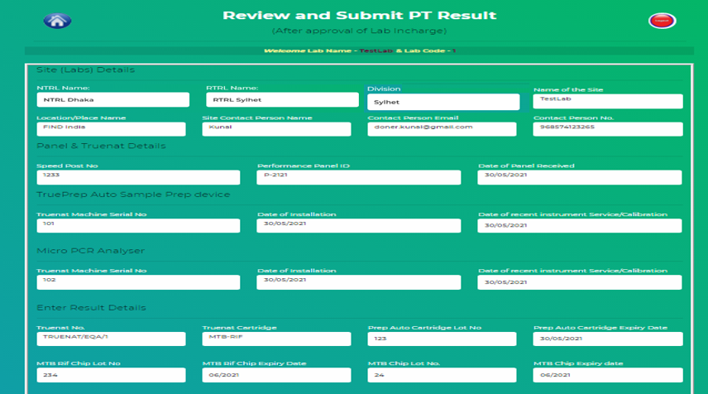
Review and Submit PT Result
Here you can see all data entered and Reviewer can edit/ correct as required

Slide 26
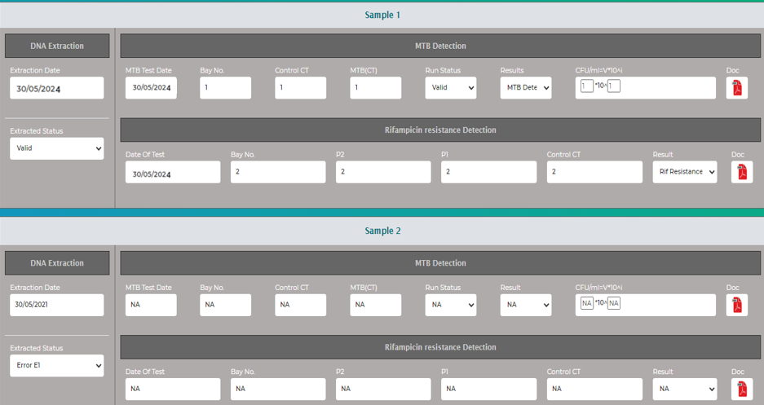
Review and Submit PT Result
All data entered is visible in edit mode

Slide 27
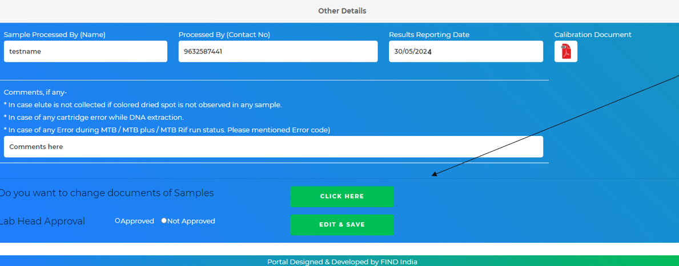
Review and Submit PT Result
Lab can view the documents submitted (MTB Result,
RIF Result,
Calibration) as required, edit/ Change them

Slide 28
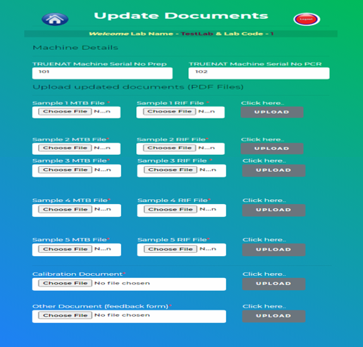
Review and Submit PT Result
Lab can re-upload their documents
for MTB Result, RIF Result, Calibration
Single sample wise by click on upload button

Slide 29
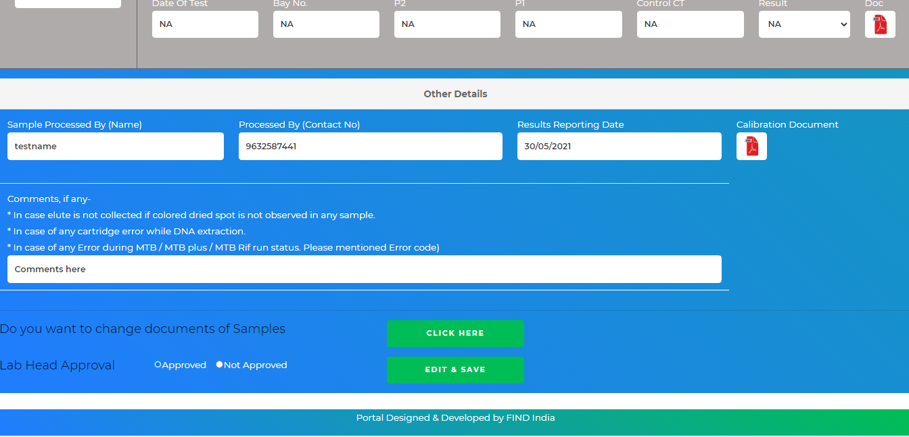
Review and Submit PT Result
Other Details
Data entered is visible in edit mode
If details will ok, then select Approved button & do final submission by click on EDIT & SAVE button
Note
Lab can’t modify the data after approval & submit

Slide 30
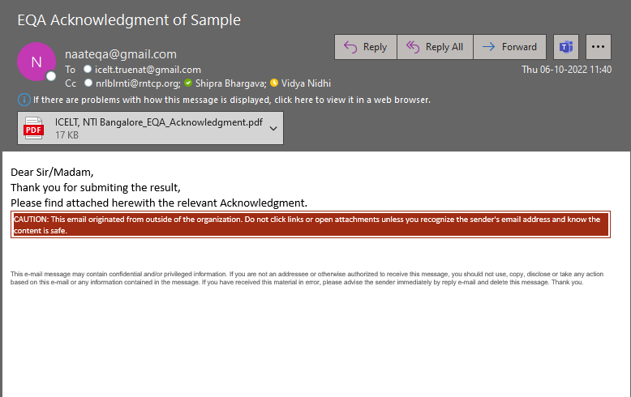
Auto generated Email to Lab
Important
Lab will receive a auto generated Email after submitted the PT Result

Slide 31
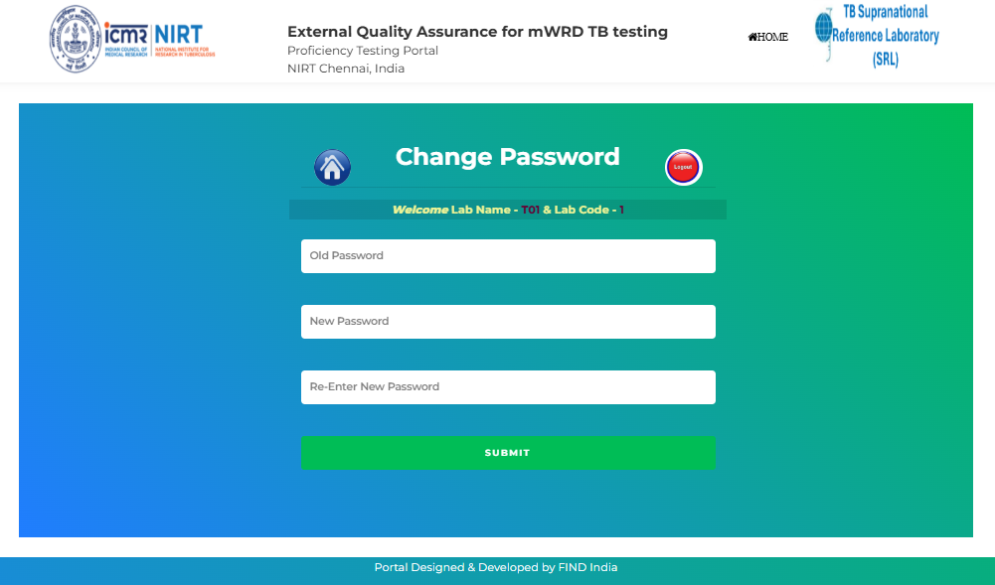
Change Password

Slide 32

Thank You

